Slide 1
Multi-Channel Exfiltration Techniques
Candidate
Mahdi Akil
1720976
Supervisor Co-supervisor
Prof. Luigi V. Mancini Prof. Daniele Venturi
A.A. 2017/2018

Slide 2

Definitions
Data Exfiltration: The unauthorized transfer of data from computers systems.
Physical or network access
Covert Channel: A communication technique to transfer information in a secretive and unauthorized manner.
Tattooed scalps
Packet headers
Packets delays

Slide 3


Reasons
Stealing information
Financial gain
Employee data
Intellectual property
Military document

Slide 4

General Problem
Share a Key
Bob
Alice
M
Covert Channel
✗
M, ECA
Watcher Defense

Slide 5
General Solution
Assumption: The watcher can disrupt at most (n-1) channels
Alice calculates the ECA for each small message using the shared key
Asks to re-transmit the unverified parts
Sends the smaller messages over multiple covert channels
Accepts the small parts where the ECA verifies
Applies Error correcting Algorithms to the small messages
Bob Divides the long message into smaller messages
Bob and Alice create multiple covert channels
Bob
Covert Channels
Alice
✗
M1, ECR
2,3, ECR
✗
M
M
M2, ECR
2,3, ECR
✓
M
✗
M
2,3, ECR
✗
M3, ECR
2,3, ECR
✓
M4, ECR
M
Watcher Defense
Share a key

Slide 6

Composing Transfer Request Packets
Find the file
Read the data (F)
Calculate the HMAC
Divide the file into chunks
Create the packet
T = HMAC(K,F)
Form the packet
HMAC of the Packet | Type = 1 | Number of Packets | Length of the file name | File Name | HMAC T

Slide 7

Sending Transfer Request Packets
Share a key & hash function
Malicious Computer
Attacker’s Server
P
P
✓
P
P
✗
P
P
✓
P
✗
P

Slide 8
Continue..
HMAC of the Packet | Type = 1 | Number of Packets | Length of the file name | File Name | HMAC T
Save
Create
HMAC T
Number of Packets
A file with the same name

Slide 9
Composing Data Packets
Divide the file into chunks
Create a data packet
HMAC of the Packet | Type = 2 | Sequence Number | Chunk of Data
HMAC of the Packet | Type = 2 | Sequence Number | Chunk of Data
HMAC of the Packet | Type = 2 | Sequence Number | Chunk of Data

Slide 10
Protocol #1 Sending Data Packets
P4
P2
P5
P3
P1
Attacker’s Server
Malicious Computer
Iteration 1
P3
P3
✗
P3
P3
✓
P3
✓
P3
P3
✗
P3

Slide 11
Continue..
P4
P2
P5
P1
Attacker’s Server
Malicious Computer
Iteration 2
P3
✗
P1
P1
P1
✓
P1
P1
✗
P1
P1
✓
P1

Slide 12
Continue..
Attacker’s Server
Malicious Computer
Iteration q
P3
P1
P2
P5
P4

Slide 13
Protocol #2 Sending Data Packets
Available packets
List of Successfully Delivered Packets (L)
P4
P2
P5
P3
P1
Attacker’s Server
Malicious Computer
Iteration 1
1
3
P3
P3
✓
P2
✗
P2
P1
✓
P1
P5
✗
P5

Slide 14
Protocol #2 Ack Packet
Available packets
List of Successfully Delivered Packets (L)
P4
P2
1
P5
3
P3
P1
Attacker’s Server
Malicious Computer
L
L
L
L

Slide 15
Continue..
Available packets
List of Successfully Delivered Packets (L)
P4
P2
P5
Attacker’s Server
Malicious Computer
Iteration 2
P1
P3
P5
P5
✓
2
P2
✗
5
P2
P2
✓
P2
P5
✗
P5

Slide 16
Protocol #2 Ack Packet
Available packets
List of Successfully Delivered Packets (L)
P4
P2
2
P5
5
Attacker’s Server
Malicious Computer
L
L
L
L

Slide 17
Continue..
Available packets
List of Successfully Delivered Packets (L)
P4
Attacker’s Server
Malicious Computer
Iteration 3
P1
P3
P4
P4
✓
P2
P4
✗
P5
P4
P4
✓
P4
P4
✗
P4

Slide 18
Security Model
Round Complexity: Number of iterations needed by the protocols to deliver the complete file.
Communication Complexity: Number of bits sent w.r.t the size of the file.

Slide 19
Best Case Scenario
6 packets, 6 channels
4 packets, 6 channels
2 packets, 6 channels
P5
P5
Round #1 = 2 packets correctly delivered
Round #2 = 2 packets correctly delivered
Round #3 = 2 packets correctly delivered
P3
P6
P5
P4
P2
P6
P2
P3
P6
P3
P6
P6
P3
P1
P3
P2

Slide 20
Worst Case Scenario
3 packets, 6 channels
6 packets, 6 channels
2 packets, 6 channels
1 packets, 6 channels
4 packets, 6 channels
Round #1 = 2 packets correctly delivered
Round #2 = 1 packet correctly delivered
Round #3 = 1 packet correctly delivered
Round #4 = 1 packet correctly delivered
Round #5 = 1 packet correctly delivered
P2
P5
P3
P2
P4
P5
P6
P2
P6
P6
P6
P3
P3
P2
P3
P1
P5
P2

Slide 21


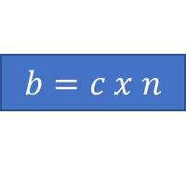
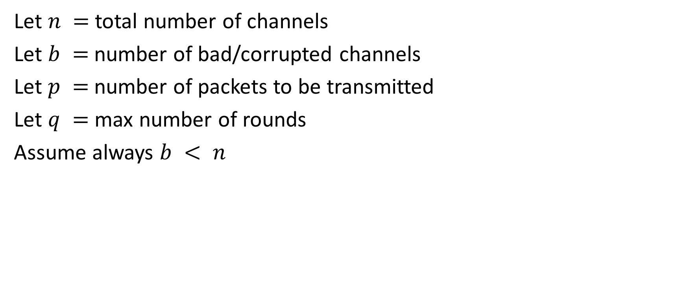
Mathematical Logic
Let $n =$ total number of channels
Let $b =$ number of bad/corrupted channels
Let $p =$number of packets to be transmitted
Let $q =$ max number of rounds
Assume always $b < n$
$$b=c x n$$
Available packets
P4
P2
$$b=\frac{1}{2} n$$
$$b=\frac{1}{3} n$$
P3
P1

Slide 22

Mathematical Equations
$$∑min\# of Packets Correctly Delivered After q Rounds \\ = \\ \sum_{i=1}^{q}{[ \left(1−c){× c}^{\left(i−1\right)}× n\right) ]}$$
$$Communication Complexity cc=n × s × r$$
$effiency∊ =\frac{f}{cc} × 100$
Packet Size
Total rounds
Available channels
Available channels after doubling some packets
# Round
Fraction of good channels
File Size

Slide 23
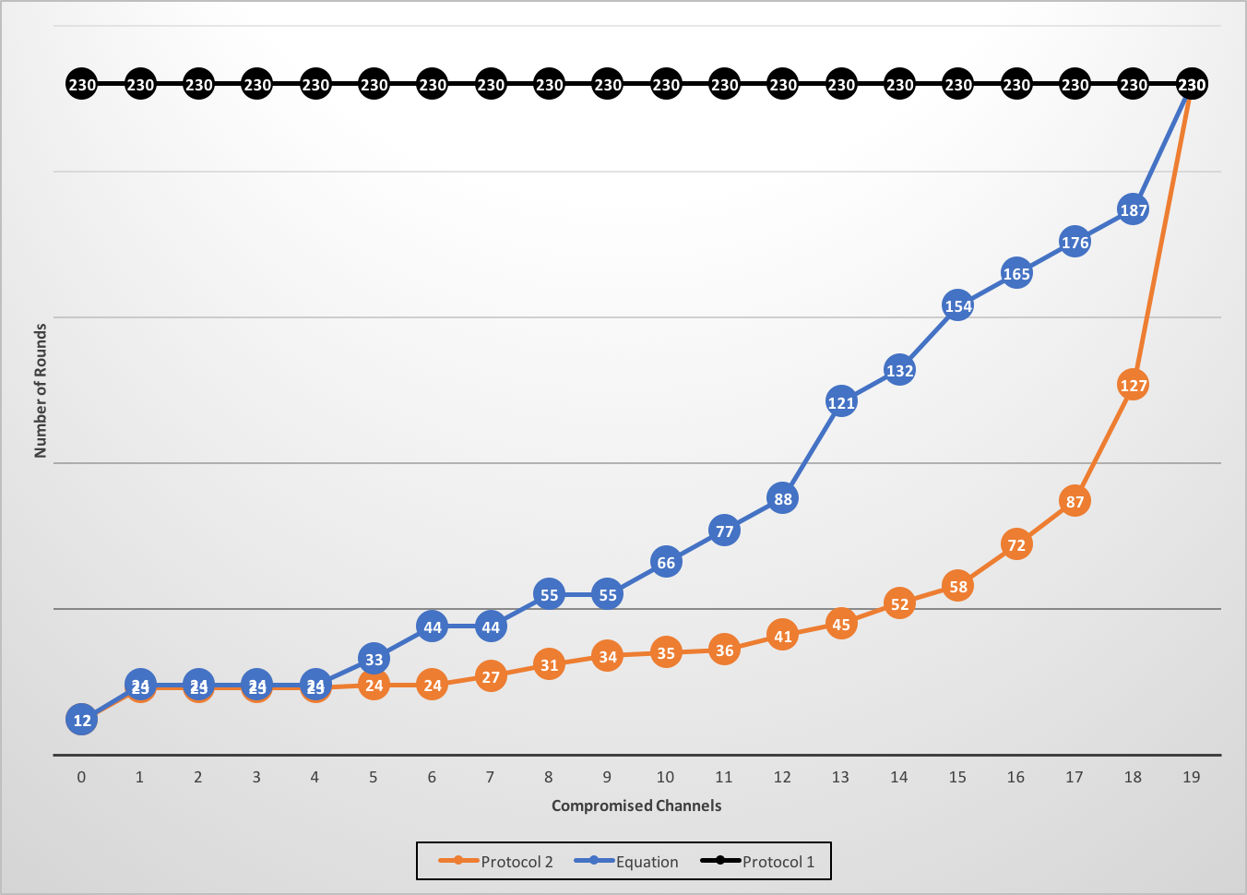
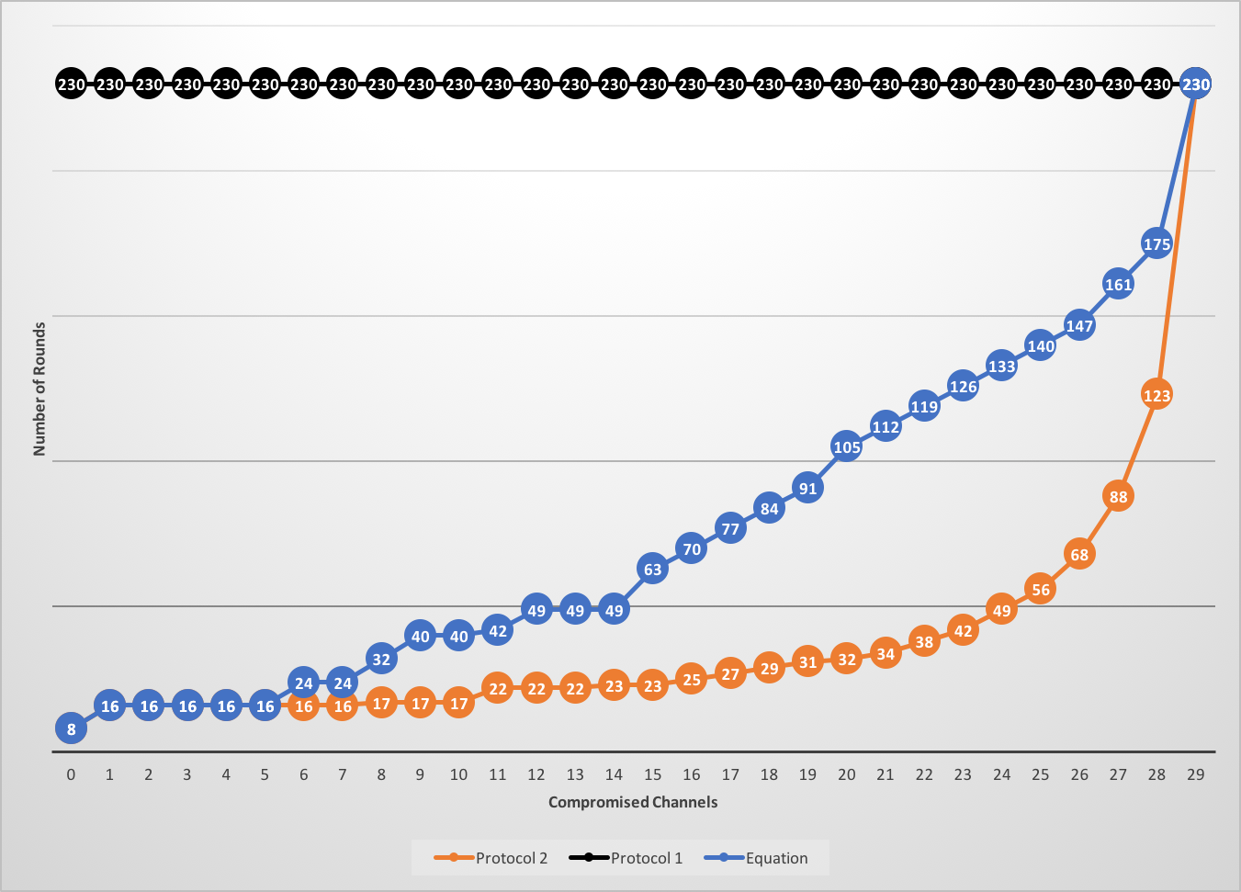
Experiments
20 Channels
30 Channels

Slide 24
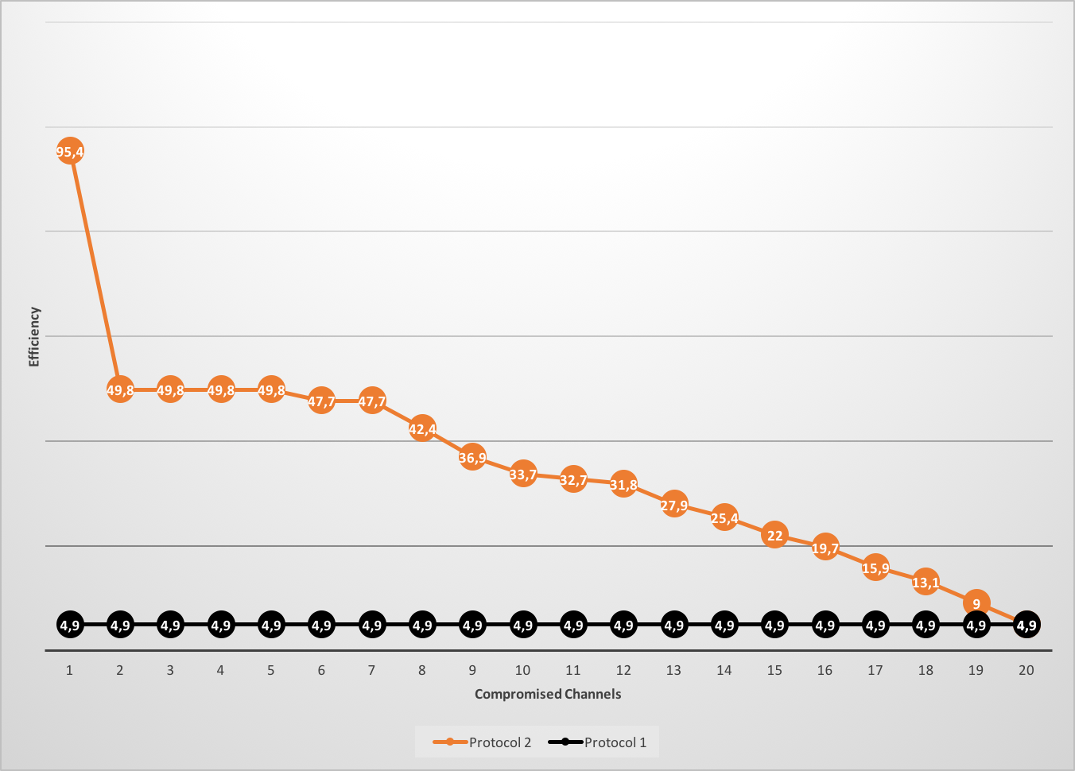
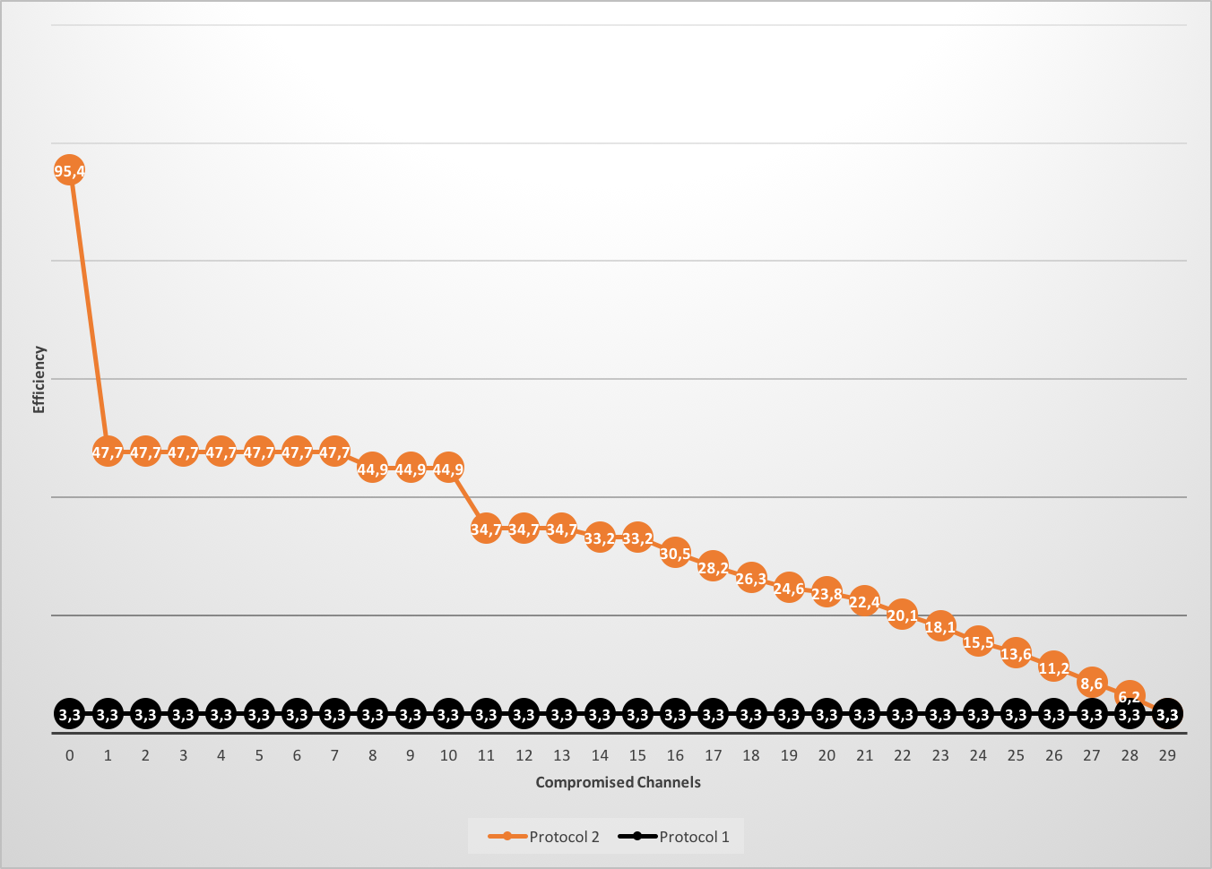
Experiments
20 Channels
30 Channels

Slide 25
Conclusions & Future Work
Create a novel protocol that uses multiple covert channels working in parallel
Used cryptographic tools to prove the authenticity of the packets between a client and a server
Proved that the protocols work even in the presence of a watcher who is disrupting more than 90% of the channels
Introduce the concept of “Fast Watcher” who has the ability to add noise to different channels in a fast way that could aid in slowing down the exfiltration technique

Slide 26
Thank you!

